Slide 1

Customer Shopping Behavior Analysis
Presented by Nikhil Mohan Tattfale
February 7, 2026

Slide 2
Project Overview & Goals
This project analyzes e-commerce transactional data from 3,900 customer purchases to uncover key shopping patterns and support data-driven strategies.
1
2
Identify Customer Segments
Analyze Product Preferences
Understand different customer groups based on their spending habits.
Determine which products are most popular and why.
3
4
Subscription Trends
Data-Driven Strategies
Examine customer subscription behavior and its impact.
Provide actionable insights for business growth.

Slide 3
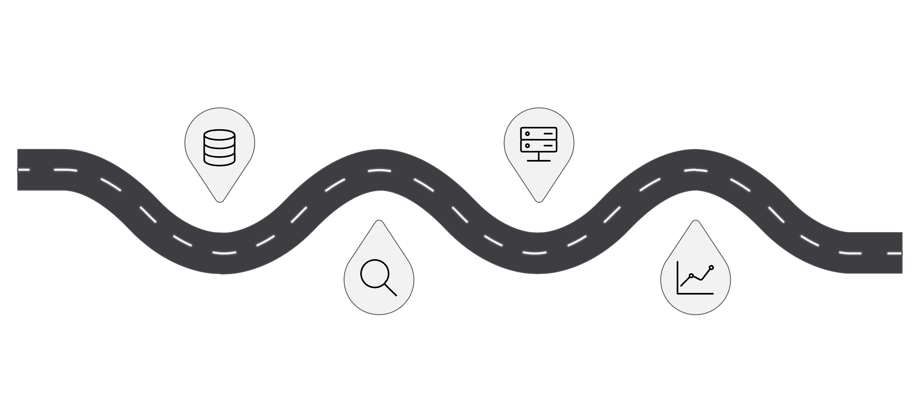

Analysis Workflow
Database Integration
Data Collection
Gather raw sources and inputs
Load and structure for access
Business Analytics
EDA & Cleaning
Inspect data and fix issues
Derive metrics and insights
Our comprehensive workflow ensures robust analysis, from raw data to actionable insights.

Slide 4
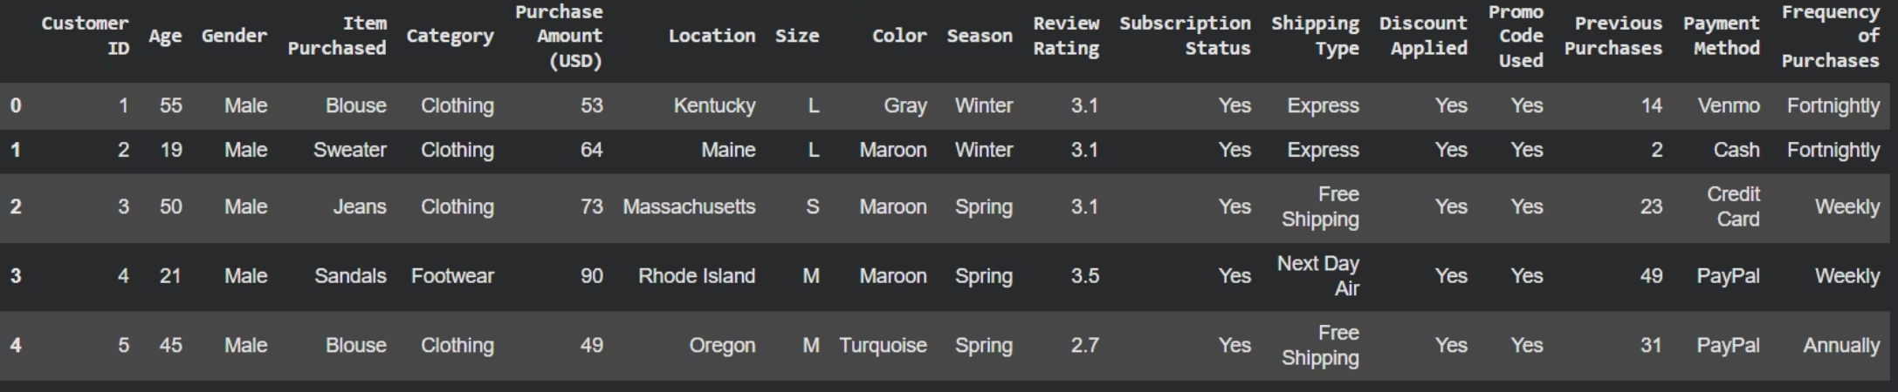
Dataset Summary
Key Features
Customer Demographics (Age, Gender, Location, Subscription)
Purchase Information (Item, Category, Amount, Season, Size, Color)
Shopping Patterns (Discount, Promo, Previous Purchases, Frequency, Review, Shipping, Payment)
3,900 rows, 18 columns. Missing data: 37 values in 'Review Rating'.

Slide 5
Data Preparation & Cleaning
Using Python and Pandas, we performed essential data cleaning and transformation.
01
02
03
Data Loading & Exploration
Missing Data Handling
Column Standardization
Initial checks to understand data structure and summary statistics.
Filled 37 missing 'Review Rating' values using median per product category.
Converted all column names to snake_case for consistency.
04
05
Feature Engineering
Data Consistency Check
Created 'age_group' and 'purchase_frequency_days' for deeper analysis.
Removed redundant 'promo_code_used' column.

Slide 6
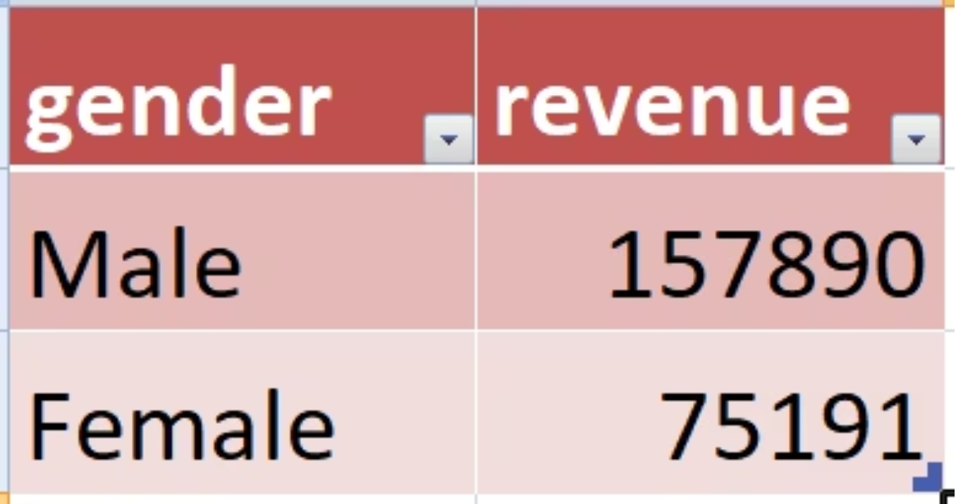
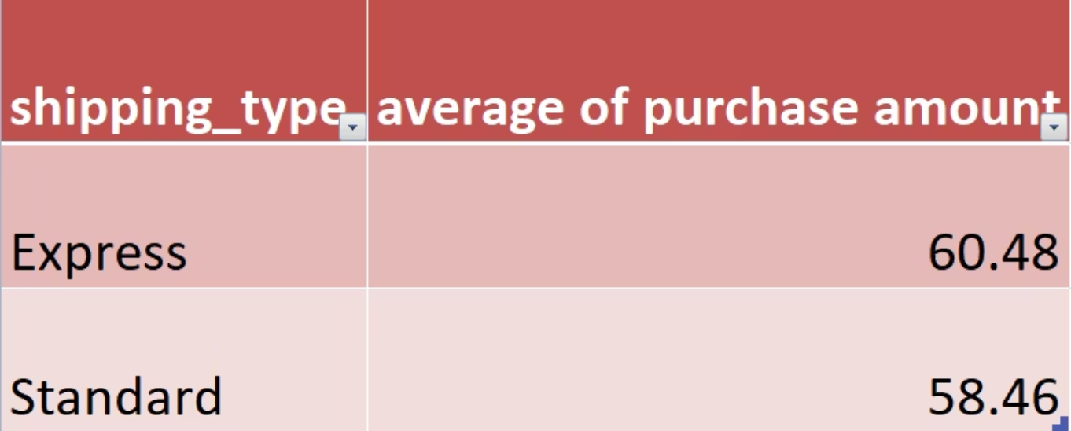
Key Business Insights from SQL
Revenue by Gender
Male customers: $157,690
Female customers: $75,191
Significant gender gap, opportunity for female targeting.
Shipping Type Comparison
Express shipping customers spend slightly more ($60.48 vs $58.46).
Correlation between urgency and spending observed.

Slide 7
Product Performance & Customer Behavior
Top 5 Products by Rating
Gloves (3.86), Sandals (3.84), Boots (3.82) are top-rated. Prioritize these in marketing.
Discount-Dependent Products
Hat (50%), Sneakers (49.66%), Coat (49.07%) show high discount rates. Review pricing strategy.

Slide 8
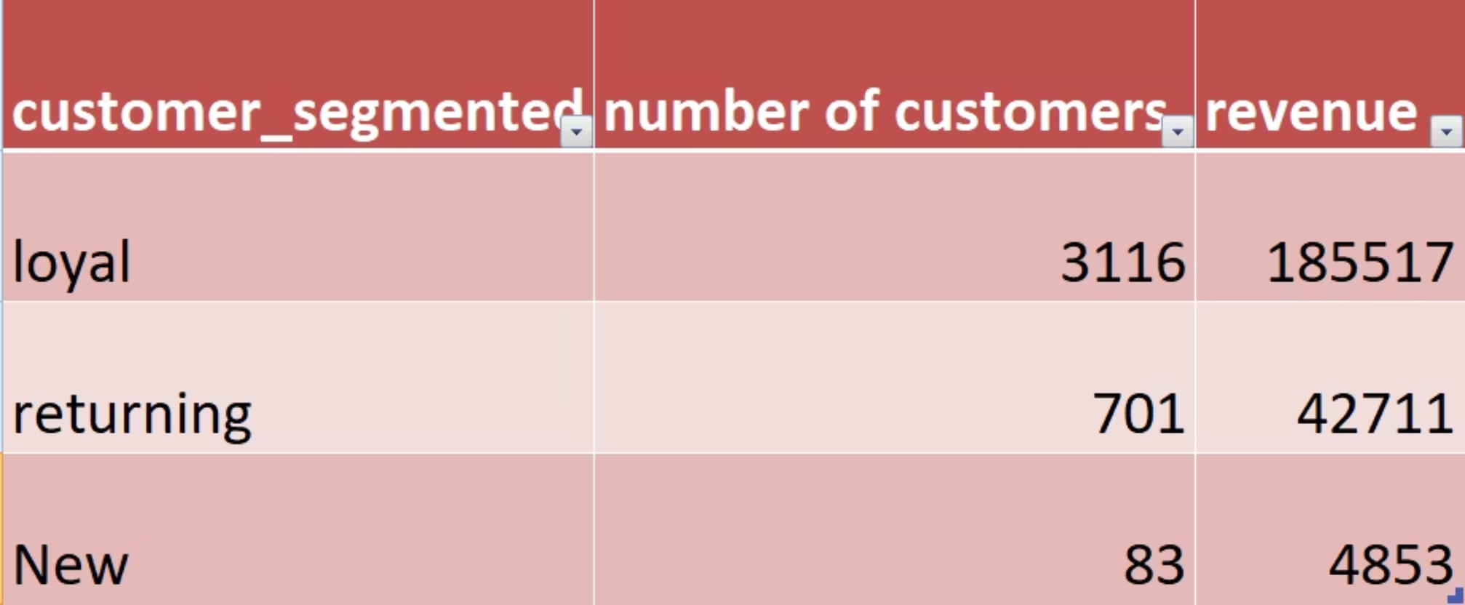
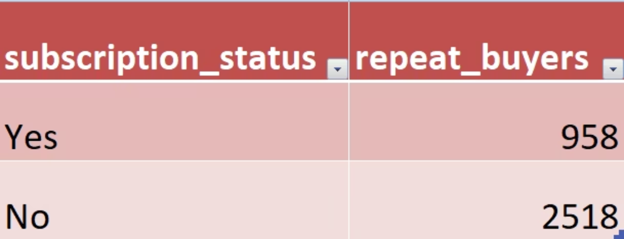
Customer Segmentation & Subscriptions
Customer Segmentation
Loyal customers (80%) drive most revenue, but new customer acquisition is low (2%).
Focus on attracting new customers and retaining returning ones.
Repeat Buyers & Subscriptions
72.5% of repeat buyers are not subscribed.
Subscription benefits may not be compelling enough.

Slide 9
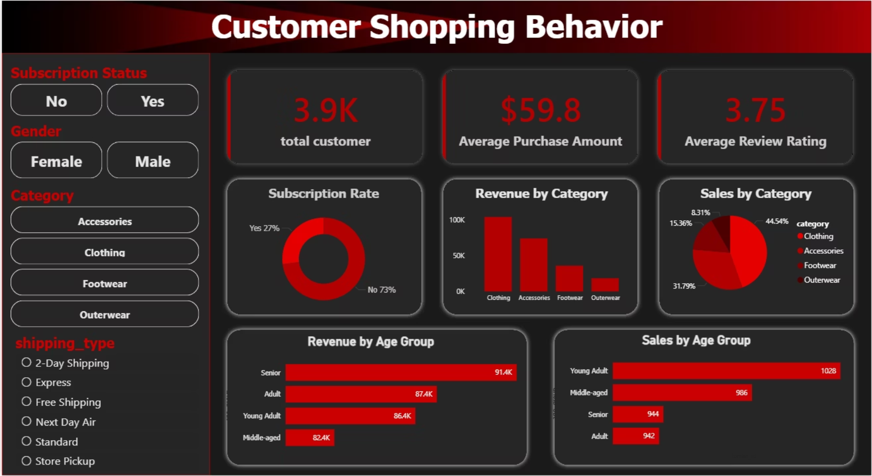
Interactive Power BI Dashboard
A dynamic dashboard for exploring key metrics and customer behavior.
Key Performance Indicators
Total Customers: 3,900
Avg. Purchase Amount: $59.8
Avg. Review Rating: 3.75/5.0
Subscription Rate: 27%
Visual Components
Revenue by Category (Clothing dominates)
Revenue by Age Group (Young Adults slightly higher)
Sales by Category & Age Group
Subscription Status Distribution

Slide 10
Business Recommendations
Expand Female Customer Base
Enhance Subscription Value
Optimize Discount Strategy
Strengthen Customer Acquisition
Targeted marketing and product expansion for women.
Exclusive discounts, free shipping, loyalty points for subscribers.
Selective discounting, flash sales, product bundles.
Referral programs, first-purchase discounts, digital marketing.
Leverage High-Rated Products
Age-Targeted Marketing
Feature top-rated items prominently in marketing and inventory.
Tailor campaigns for Young Adults, Middle-aged, and Seniors.

